Slide 1
Assessment of Restaurant locations in the greater Suffolk, MA Area
IBM Data Science capstone presentation
By Brian Barry

Slide 2
Introduction to the Dataset and Defining Our Objectives
With the high percentage of restaurant failures, a perspective restaurantor must use data available to determine location and type of venue in order to maximize chances of success.
This capstone will thus utilize publically available data from New York University, cross referenced with the Foursquare API to conduct statistical analysis
The ultimate output from this process will provide detailed guidance on successful restaurant set up in the greater Suffolk County, MA area.

Slide 3
Methodology
Goal: determine type and location of restaurant for optimized success.
The initial portions of this project will involve pulling data from NYU API, transforming to a usable data frame, cross referencing location/neighborhood and venue density.
The second portion of this capstone will utilize cluster analysis to determine restaurant density per neighborhood.
The resulting information will achieve the goal.

Slide 4
Origin of Data Used in This Project
City and town data for Massachusetts was provided at the following link as a usable JSON: https://geo.nyu.edu/download/file/harvard-mgisgeonamx2-geojson.json
This organization is the NYU Spatial Data Repository, that has a litany of GIS based data files
Foursquare API was cross referenced to provide venue information for Suffolk County, MA

Slide 5
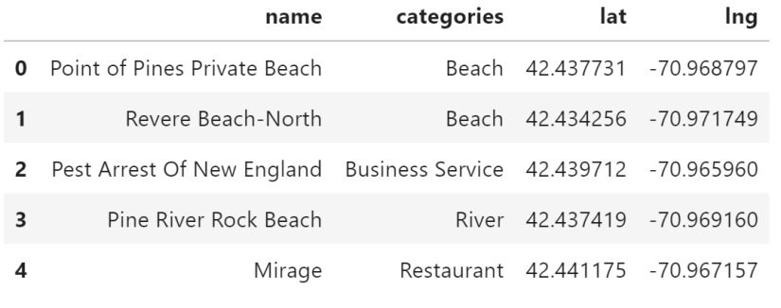
Data Cleaning
In order to have usable data for cluster analysis, it was sorted and reduced from it’s original JSON format to a DF only pertaining to Suffolk, MA

Slide 6
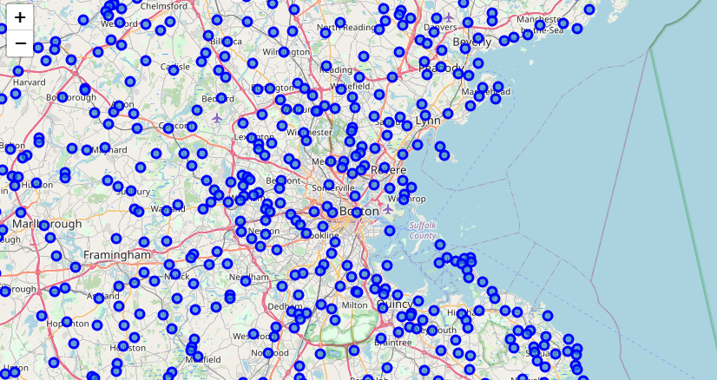
Mapping Town Data
The DF then translated to a map graphic

Slide 7
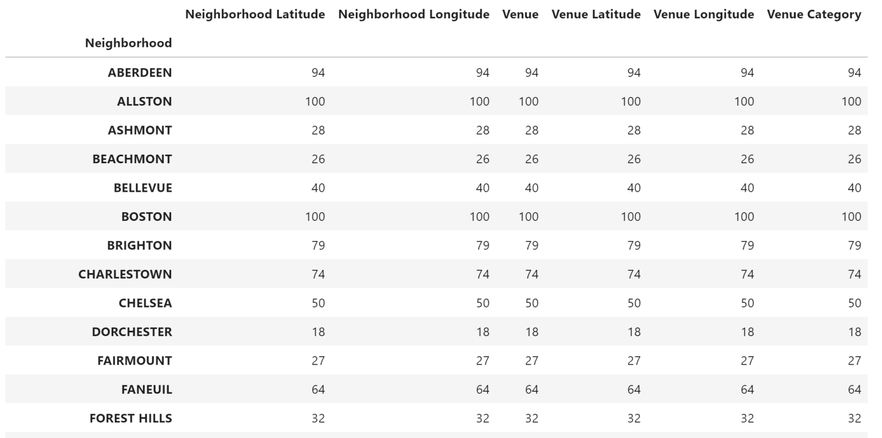
Preparation for Foursquare API Use
This Suffolk County list of towns was used for purposes of narrowing the Foursquare query, and eventual recommendations.

Slide 8
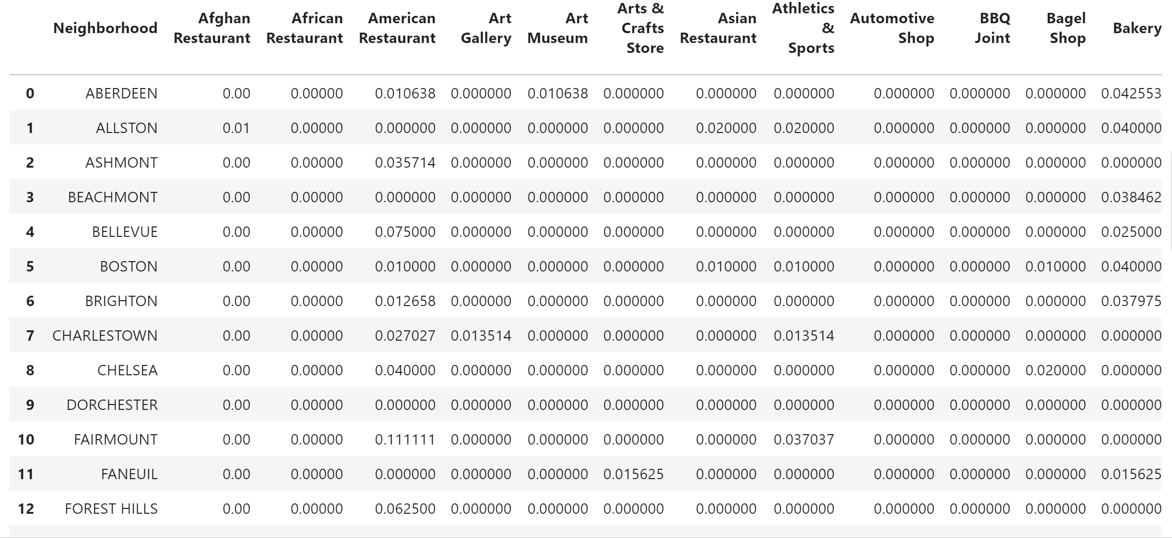
Grouping of Neighborhood Features
Basic grouping allowed averaging of each neighborhood with associated occurrence of each category pulled from the API

Slide 9
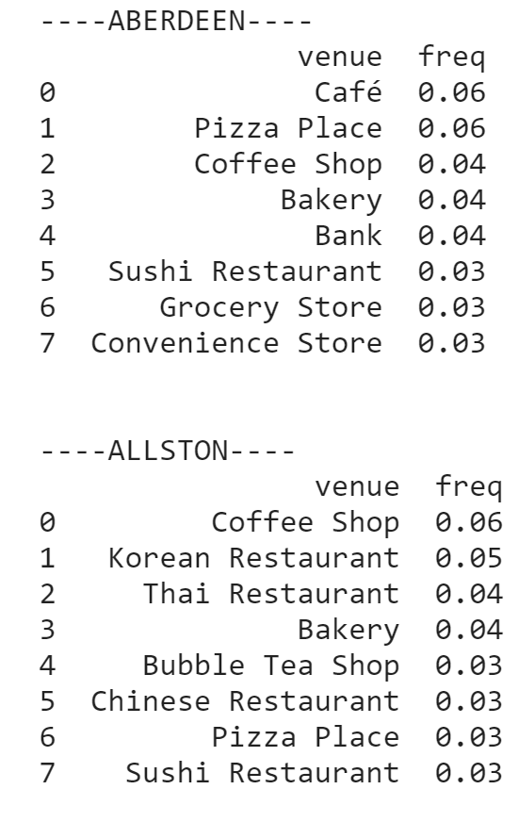
Deeper Statistical Analysis
The follow on step involved finding the average and frequency of the top five restaurant within each Suffolk neighborhood

Slide 10
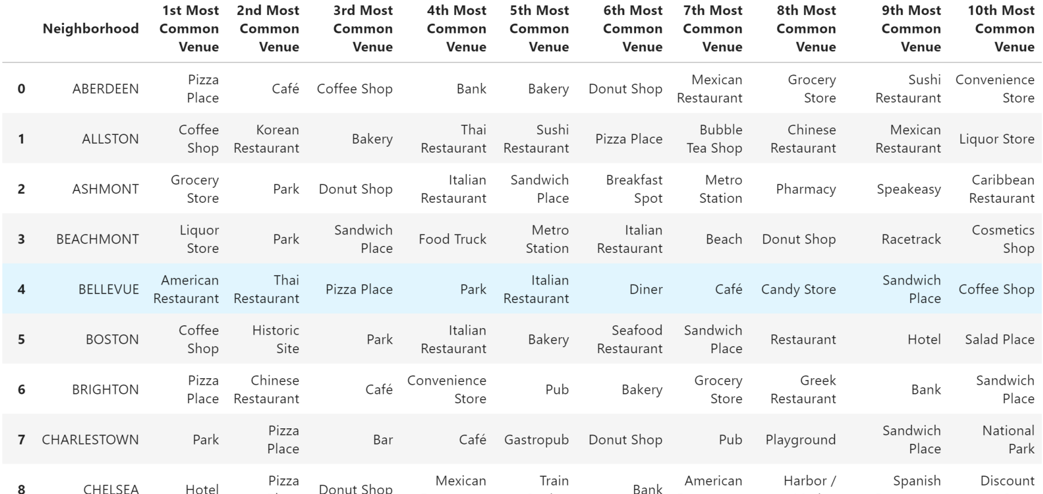
Final Manipulation of the Data Frame
Further analysis was done to determine the top ten most popular venues by town.

Slide 11
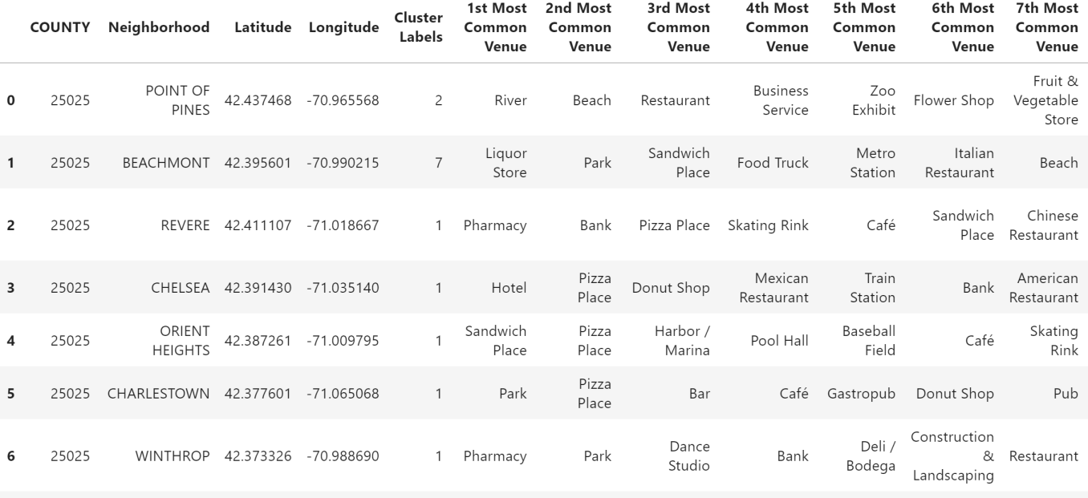
K-Means Cluster Analysis
K-means was then applied to the data frame
This process is an unsupervised machine learning algorithm, that groups similar features in a data set.
It aims to minimize intra-distance of a data set, and maximize inter-distance.
This process was conducted with k=8

Slide 12
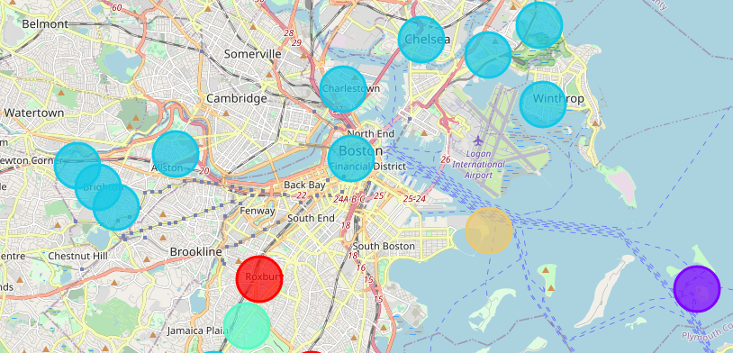
Cluster Analysis Visual Heuristic
This was followed by visually grouping each neighborhood, with the corresponding density of restaurants.

Slide 13

Data Observations
Cluster 2, an area with a preponderance corresponding to the greater Boston area, was by far the most data rich cluster.
This includes not only the most amount of restaurants, but the largest diversity of restaurants as well.
This likely corresponds with population density in these areas
The most common restaurants were: Pizza Places, Café, and Asian themed restaurants

Slide 14
Final Recommendations
Due to the density of cluster 2, it likely over-saturated with a customer base and will make starting a restaurant there more difficult.
Therefore, due to the popularity of Pizza Places, it is recommended to place one in a non-cluster 2 location.
Conversely, due to geographic analysis, the restaurants in the non-dense areas seem to be more upscale establishments, therefore this approach also seems effective.
Finally, examining those less frequently occurring venues may offer future development.

Slide 15

